Slide 1
Washington State Fatal Crash Analysis
Zizheng Zhang, Xiaoze Liu, Wangxi Pan

Slide 2

Data Source
The Washington Coded Fatal Crash (CFC) Data from WTSC and their traffic safety partners .
Data includes:
Location
Traffic Condition
Driver Information
Damage and Rescue

Slide 3
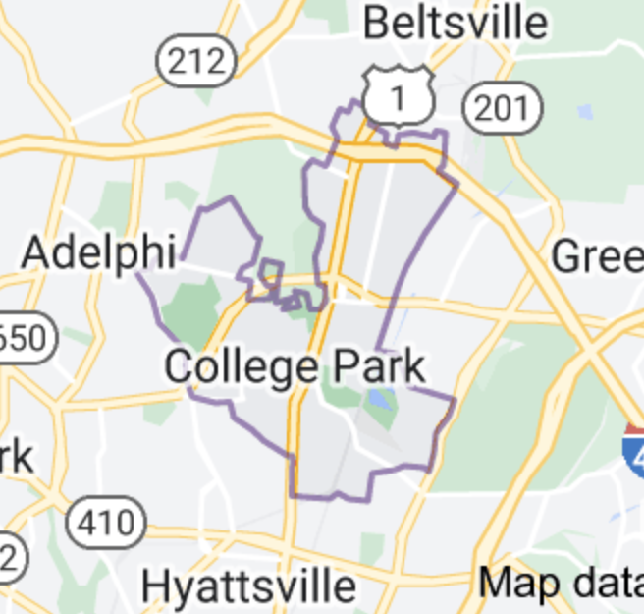
Data Process
20781
Notes:
Add x,y into graph

Slide 4
Data Process
Drive Off Road
Control/Traction Loss
Avoid Collision with Vehicle, Pedestrian, Animal
Parked Vehicle
Other (Single Driver)
Crash Type Category:
Single Driver

Slide 5
Data Process
“Impaired by Alcohol, Drugs, Meds” labeled 5 from 2003-2009
“Under the Influence of Alcohol, Drugs or Medication” labeled 15 after 2009
Driver Behavior Factor:
Physical/Mental Condition

Slide 6
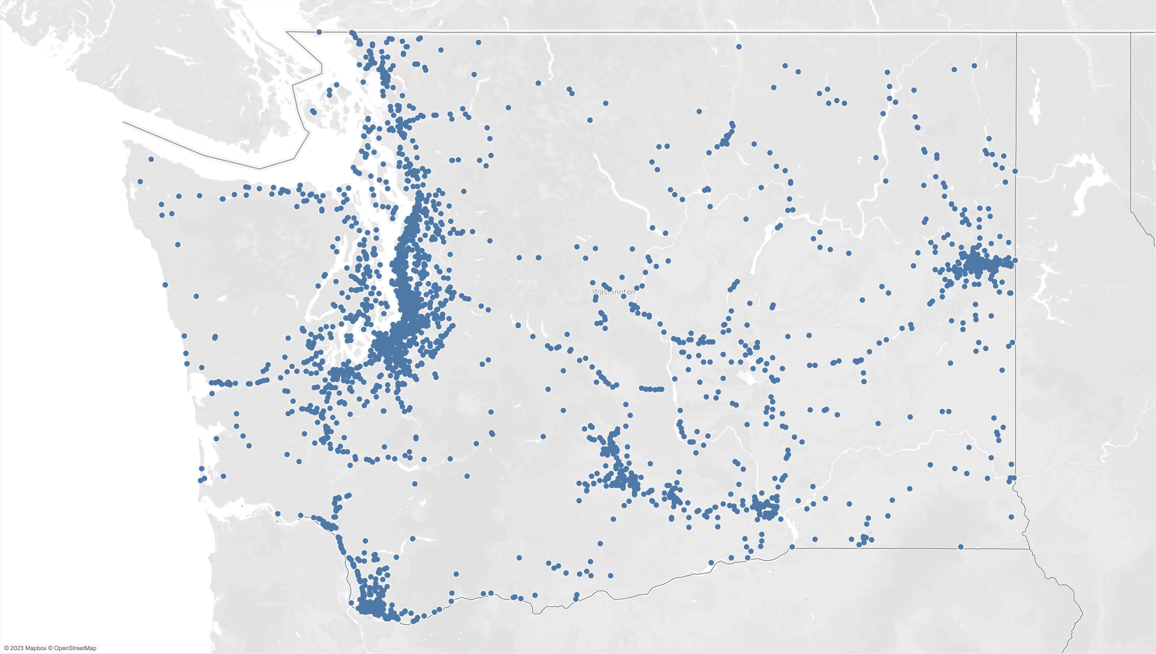
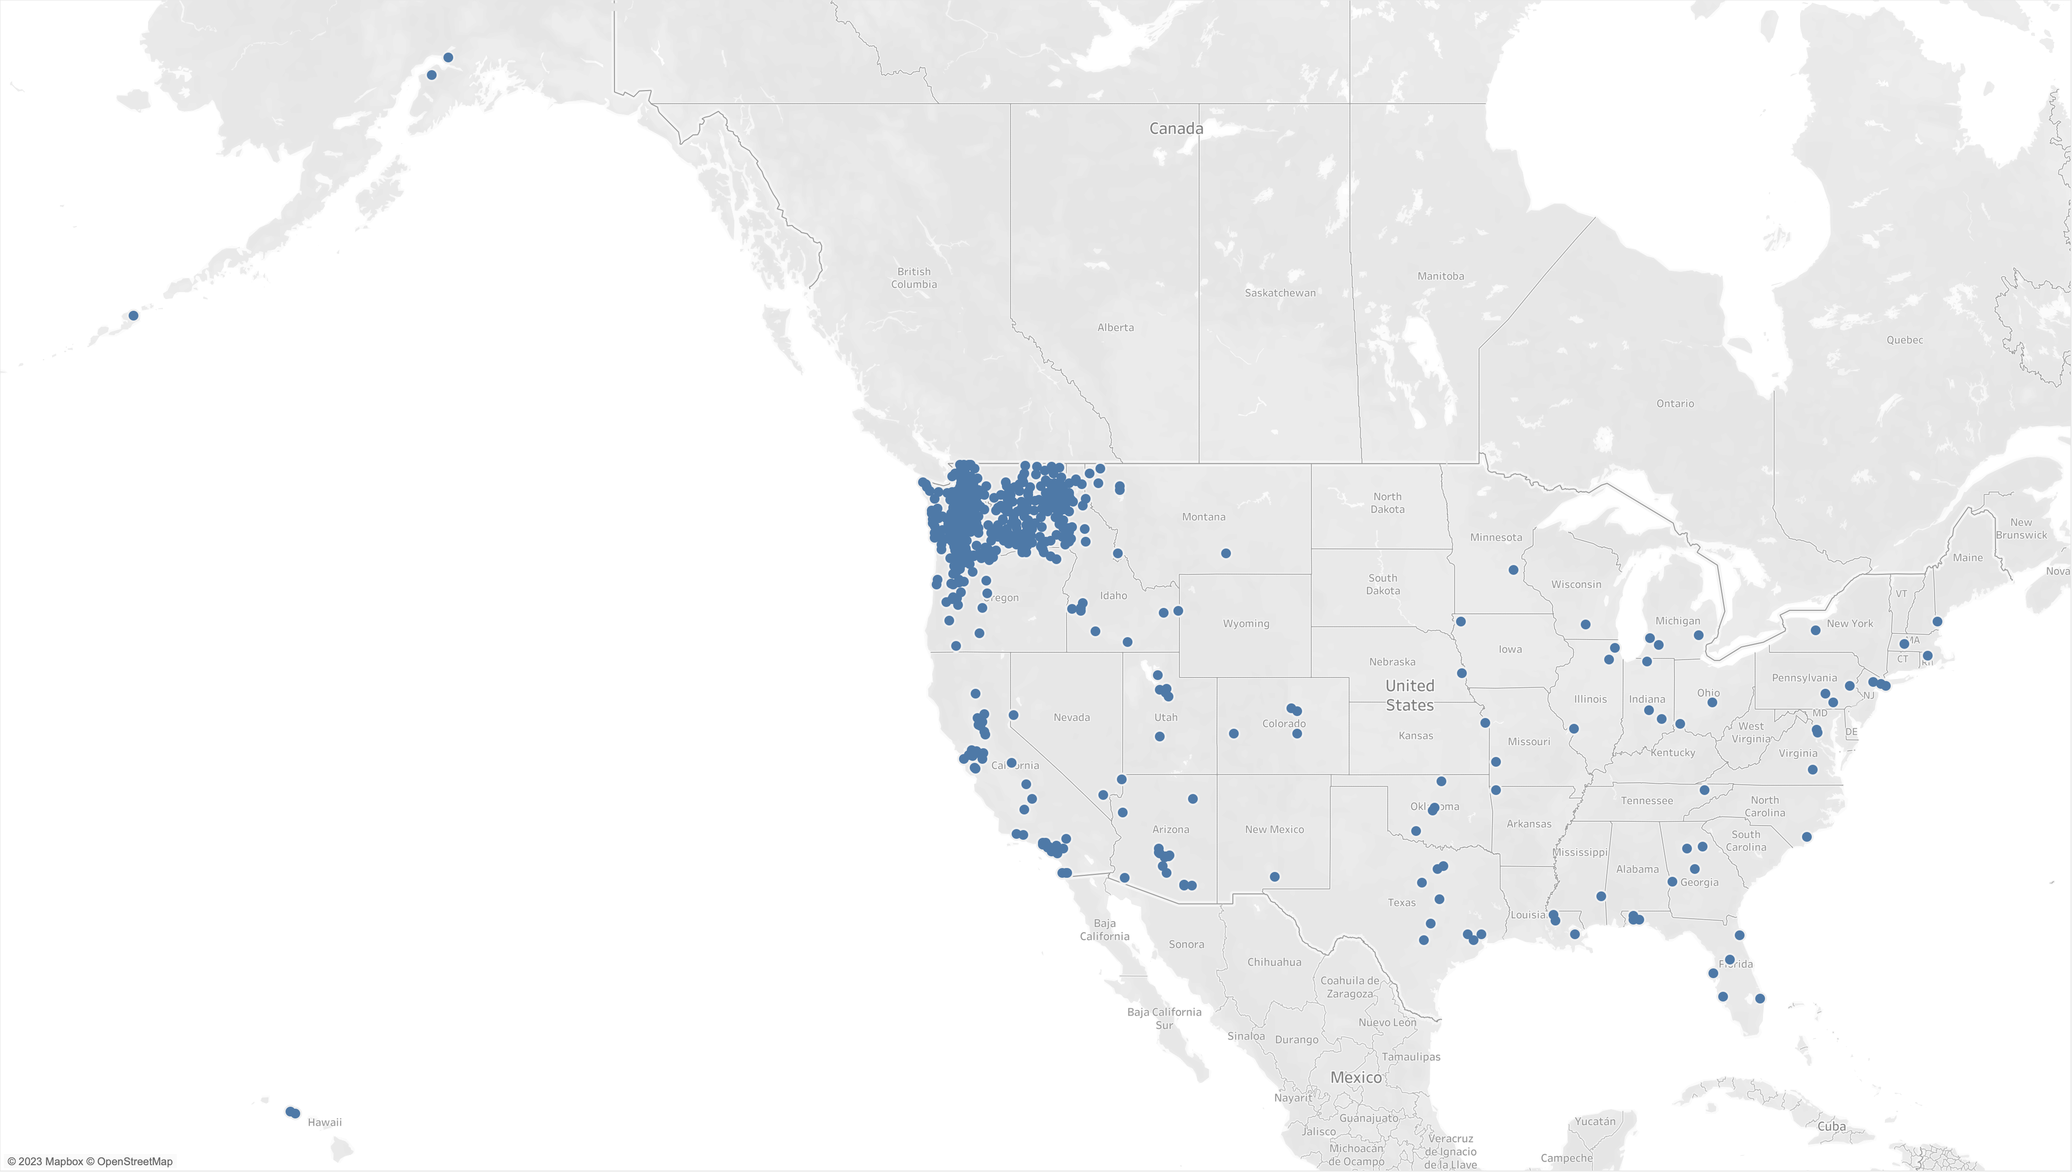
Accidents
Drivers’ Addresses
vs.

Slide 7
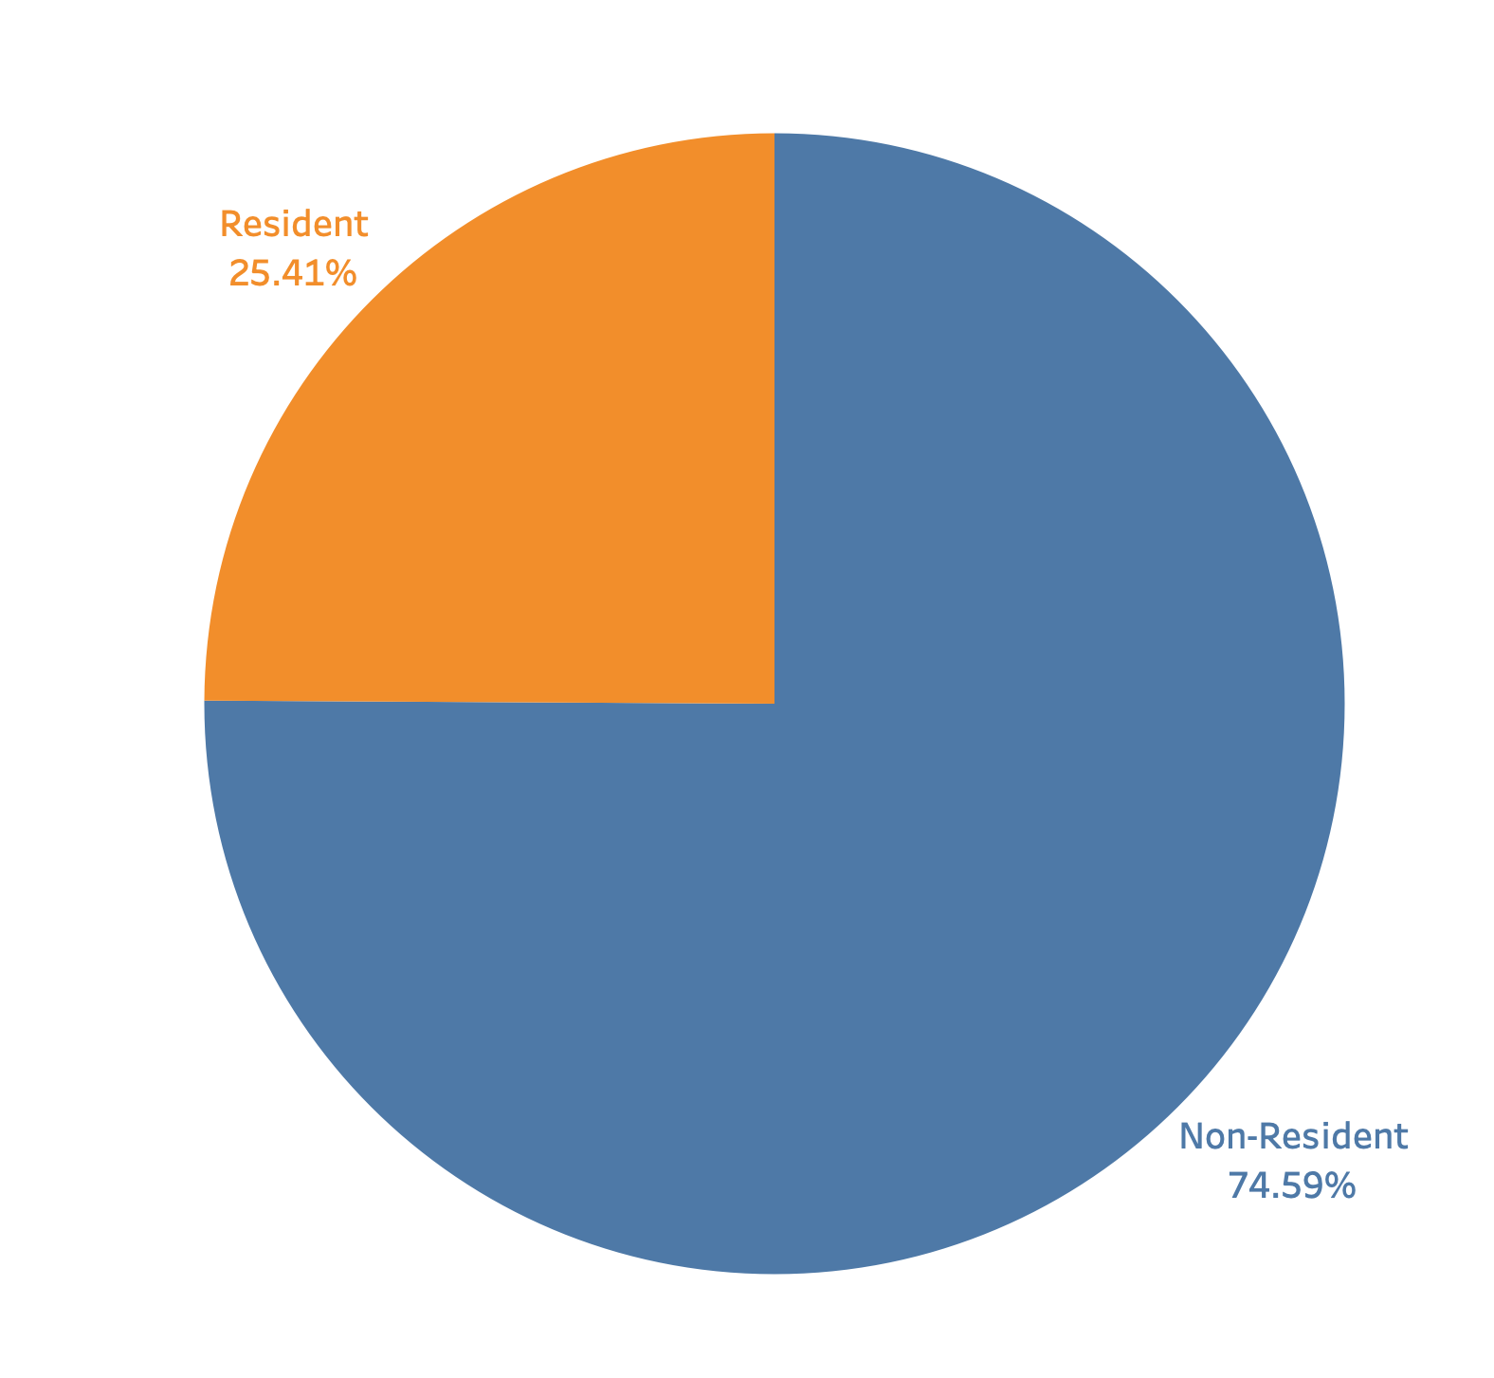
Question
Non-resident drivers shows a much higher percentage in fatal accidents.
WHY?

Slide 8
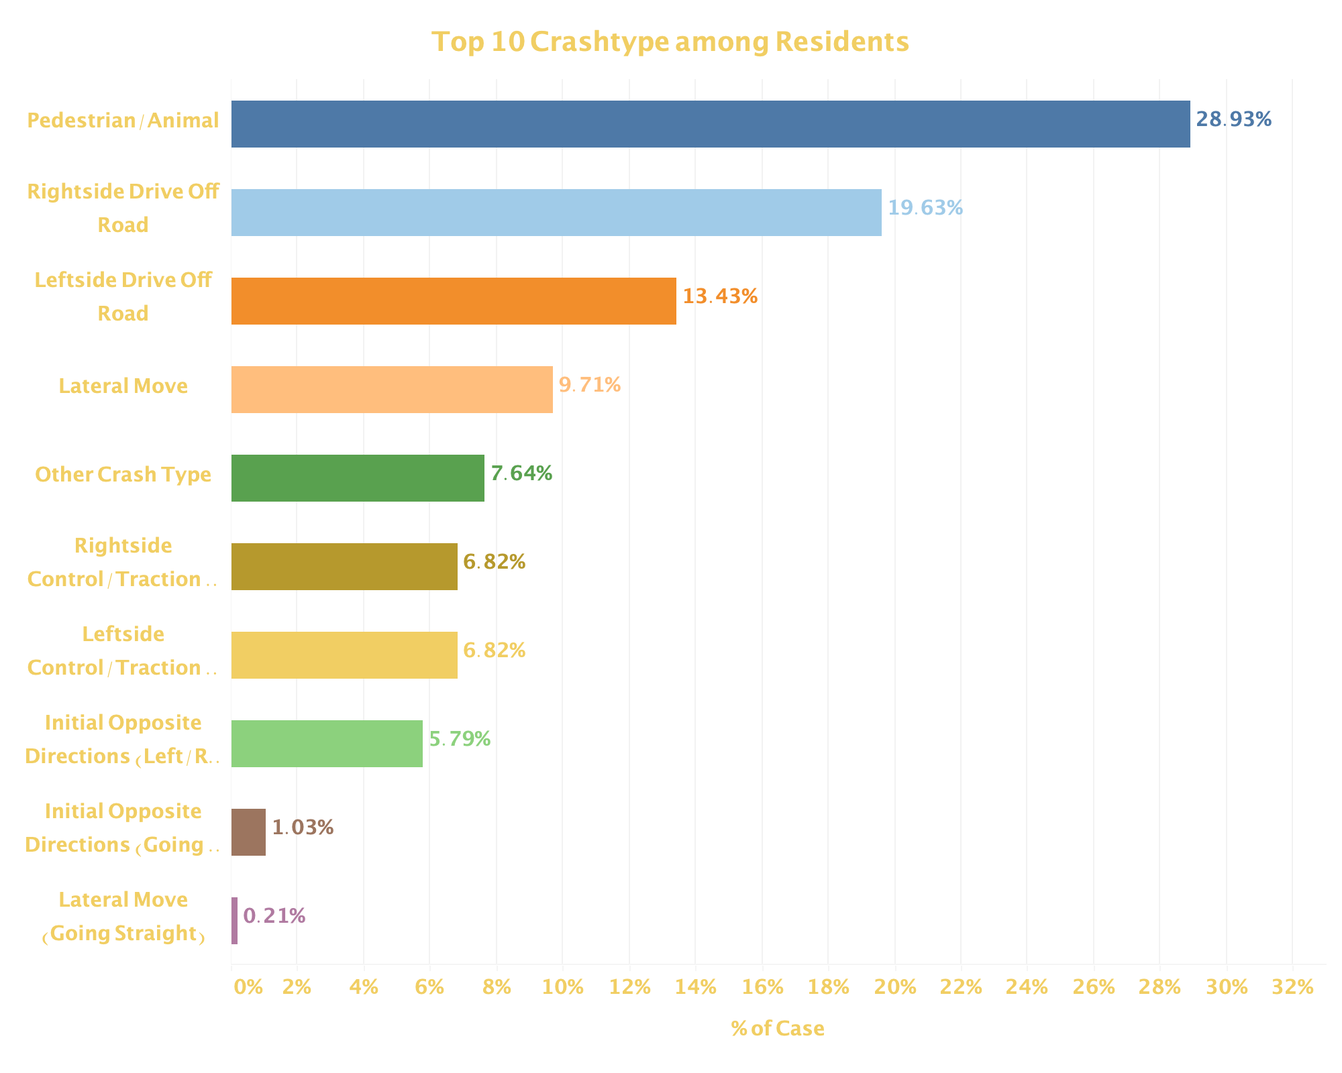
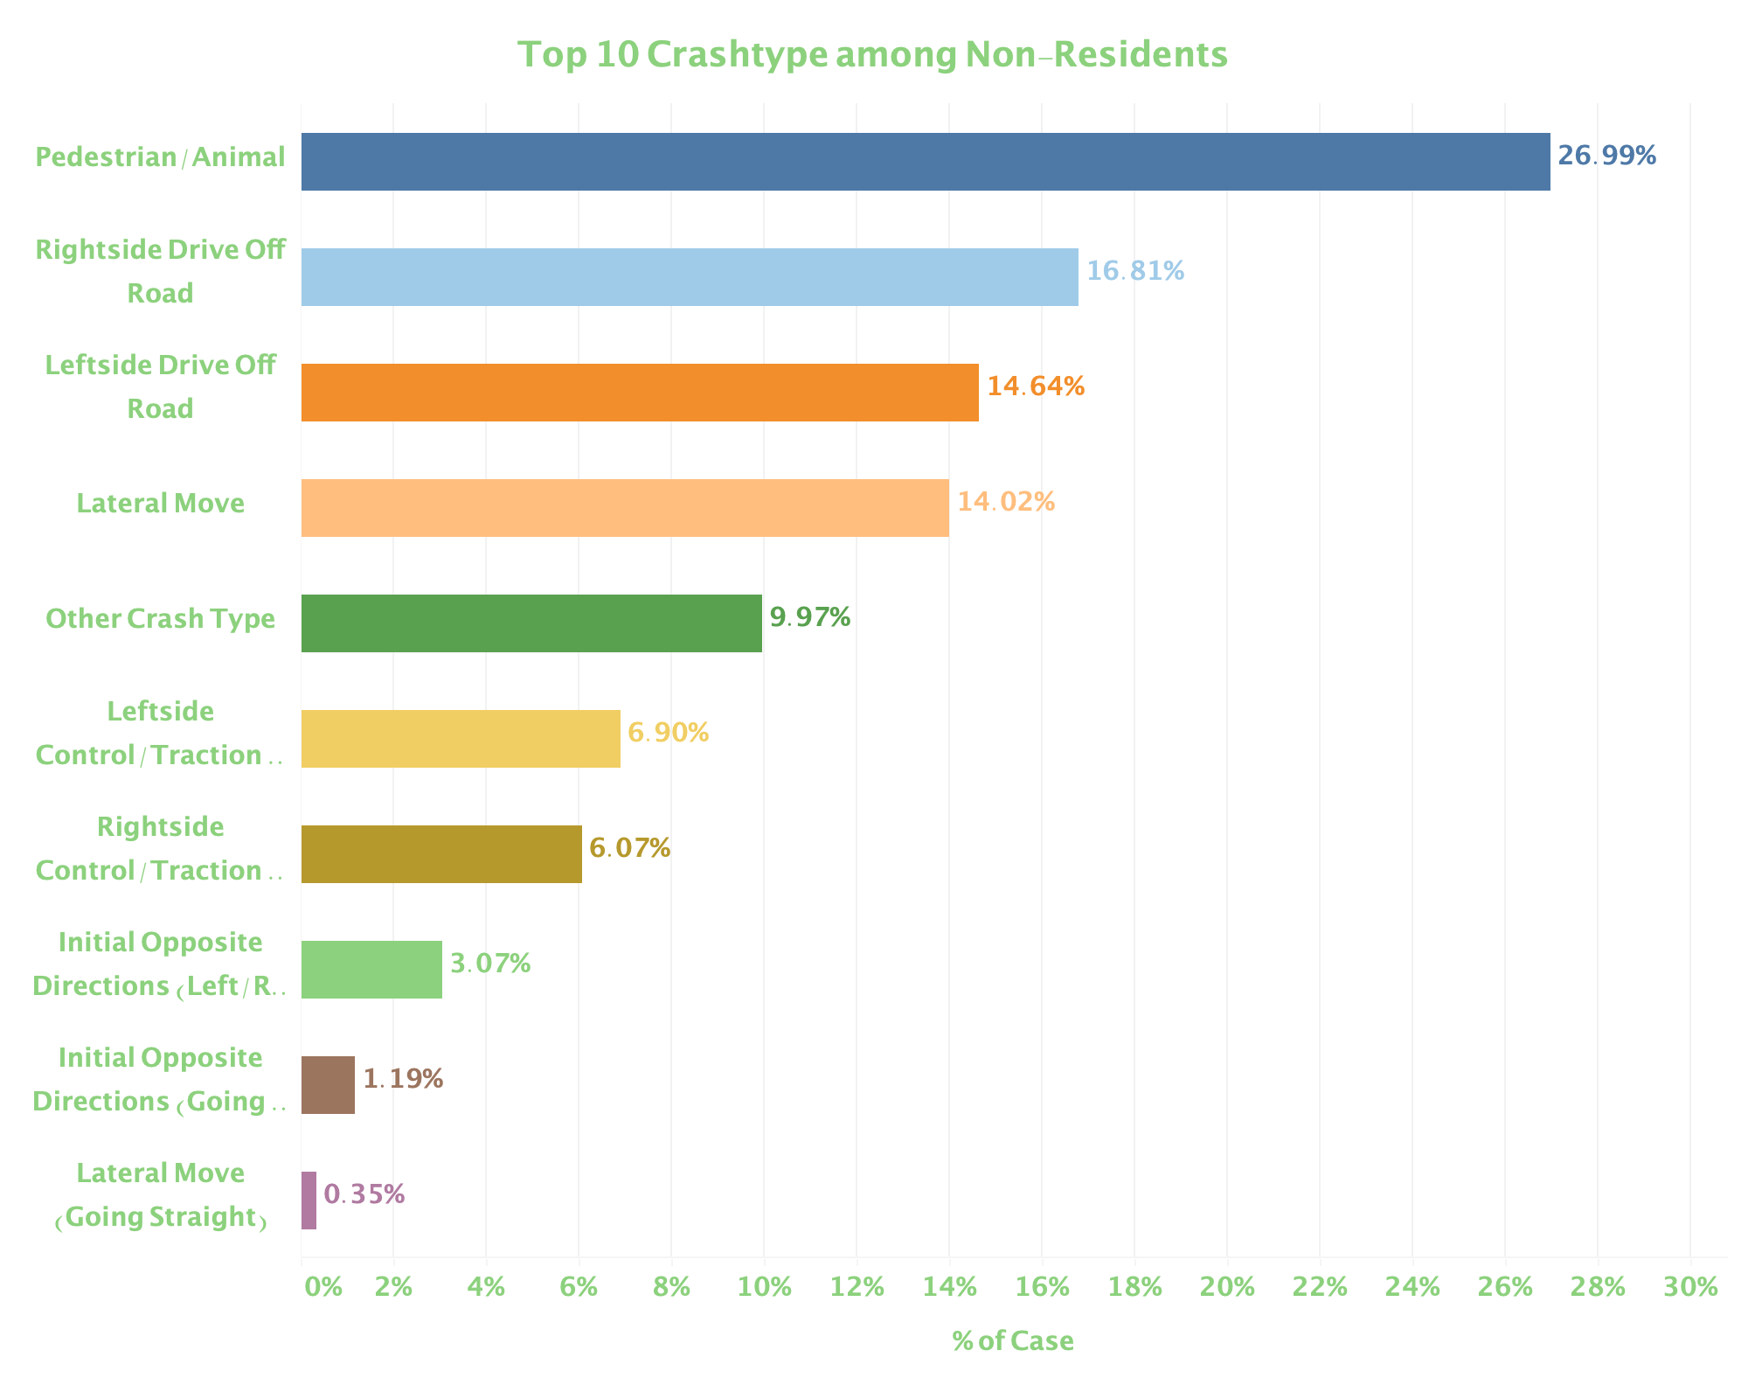
Resident VS. Non-resident
Notes:
Crash type

Slide 9
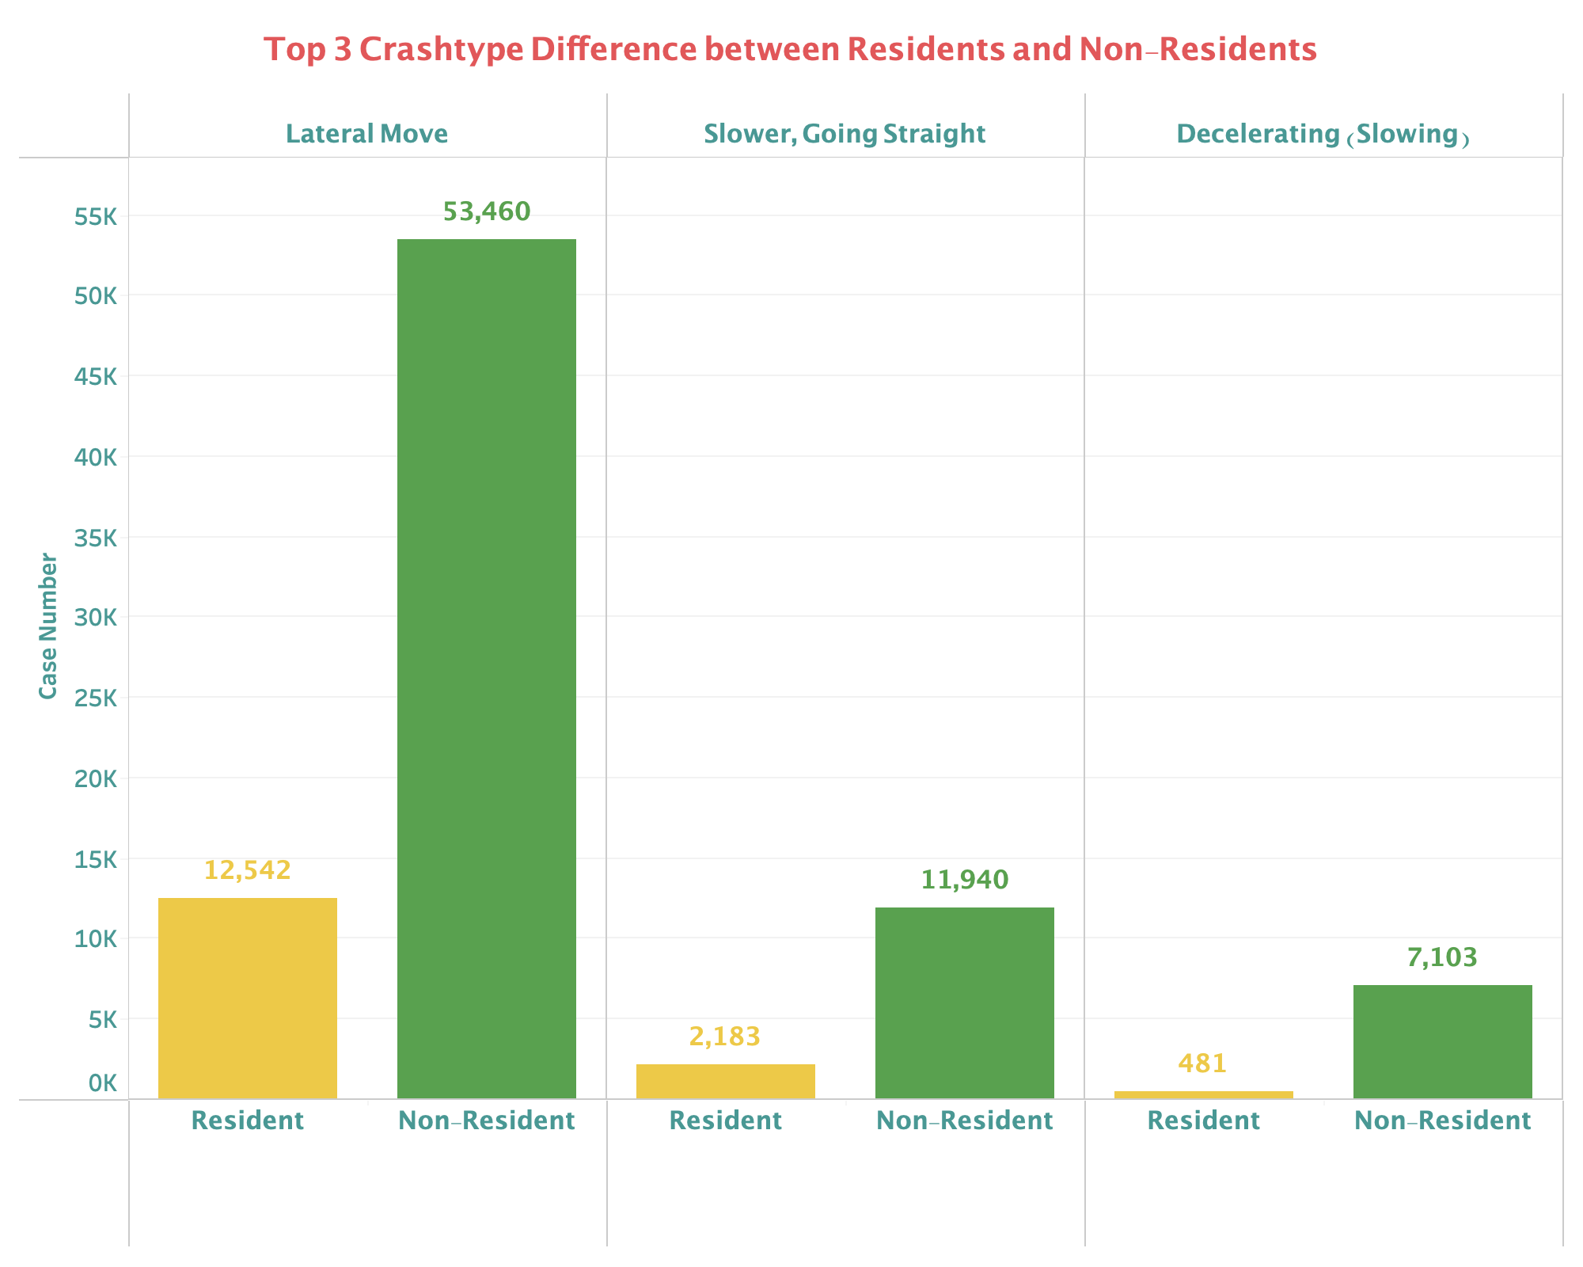
Resident VS. Non-resident
The chart shows the proportion of fatal accidents by crash categories, in resident and non-resident drivers separately.
The largest difference of case proportion appears in the crash types Lateral Move (Left/Right), Decelerating (Slowing), and Slower, Going Straight.
Notes:
Crash type

Slide 10
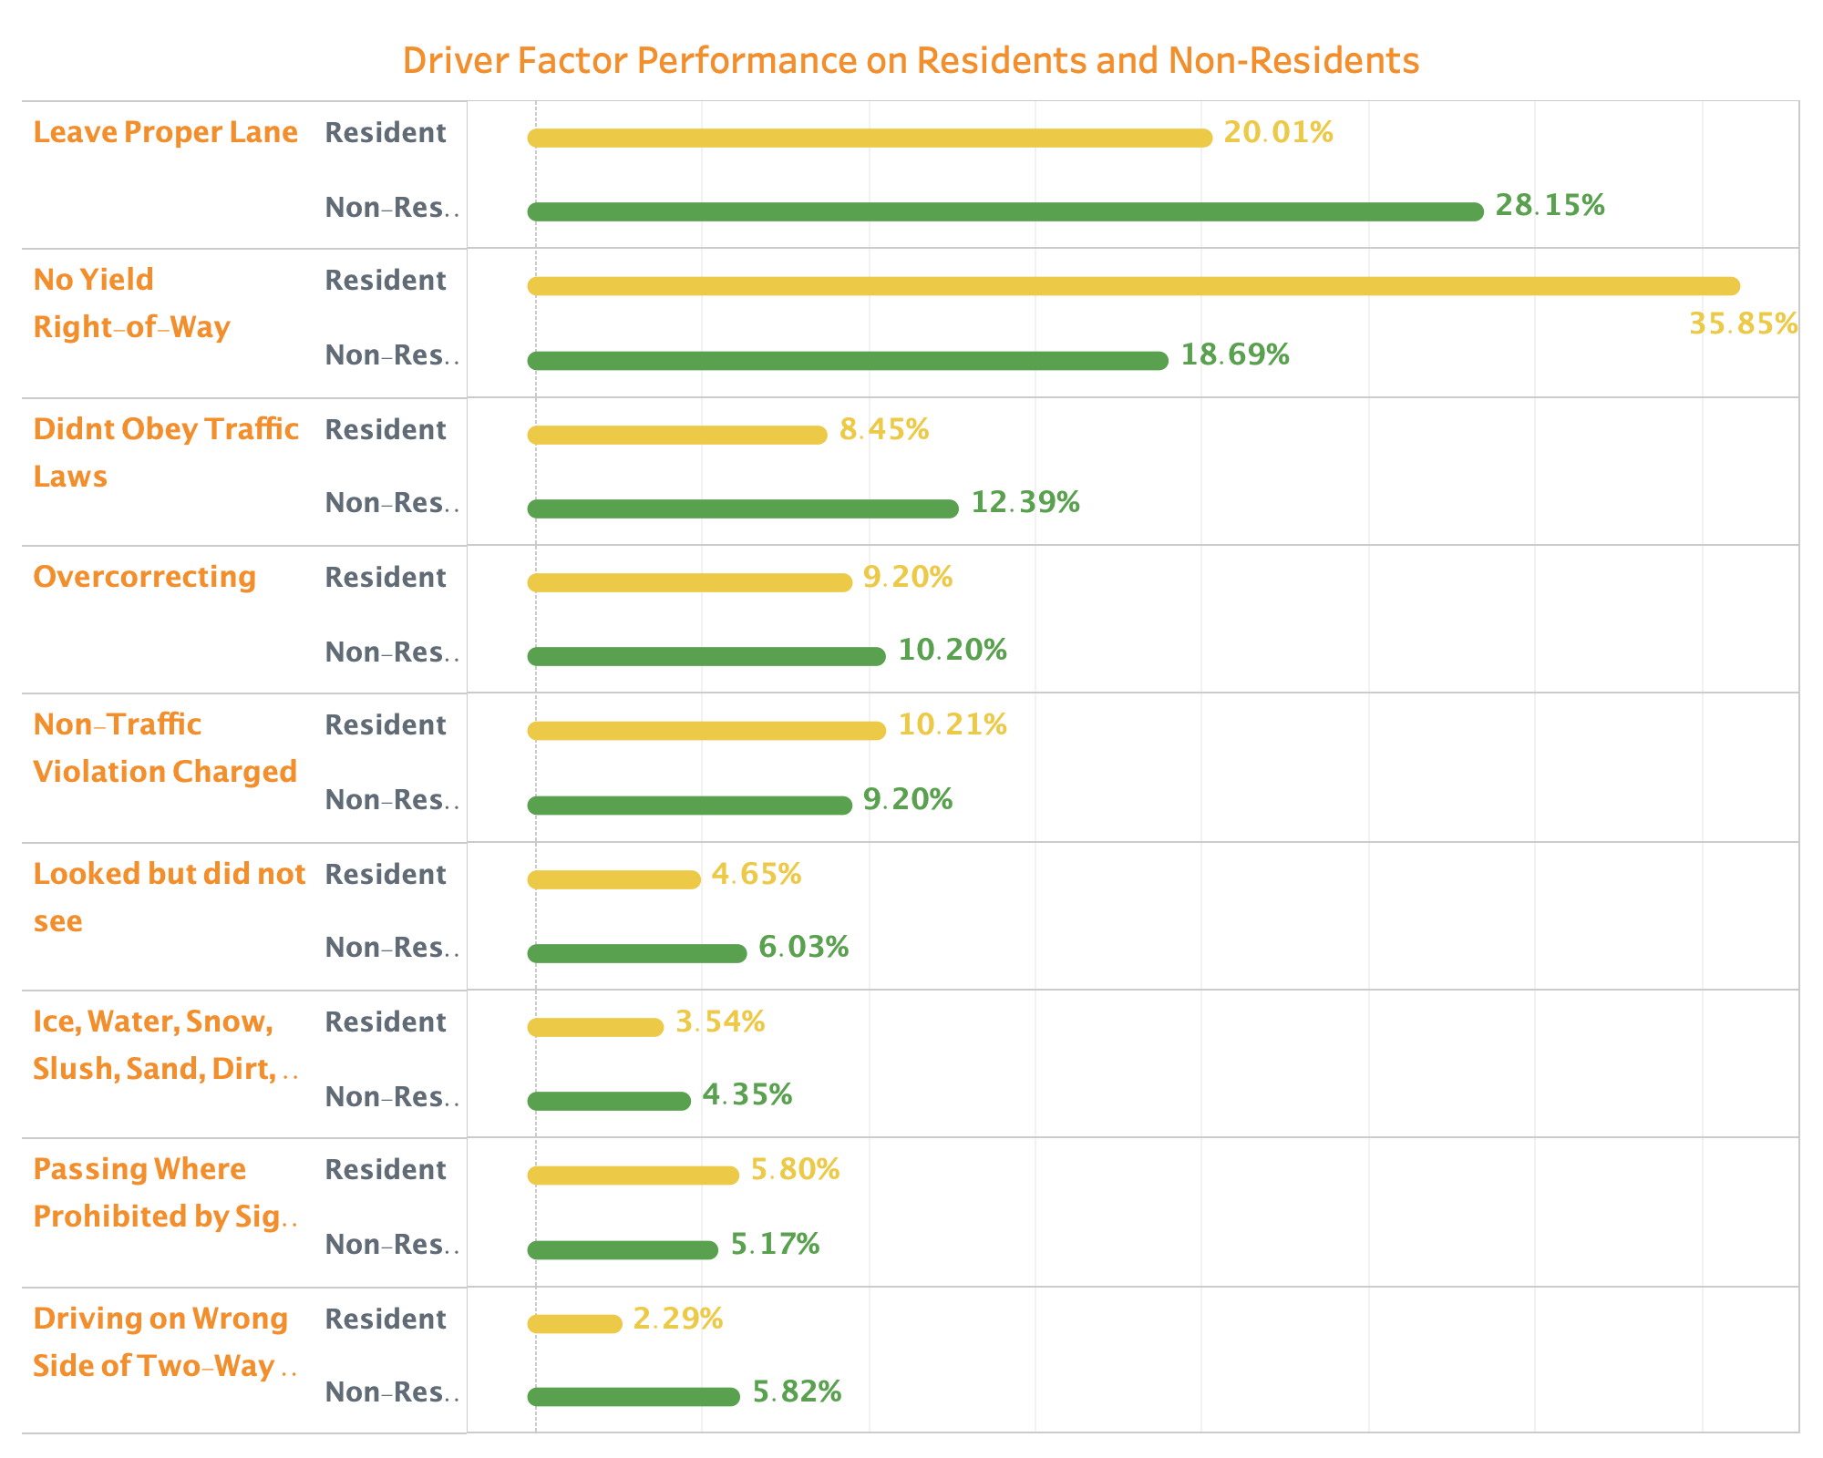
Resident VS. Non-resident
The chart shows the proportion of fatal accidents by behavior factors, in resident and non-resident drivers separately.
Compared to resident drivers, non-resident drivers are much more likely to encounter fatal accidents with leave proper lane.
Notes:
Behavior factor

Slide 11
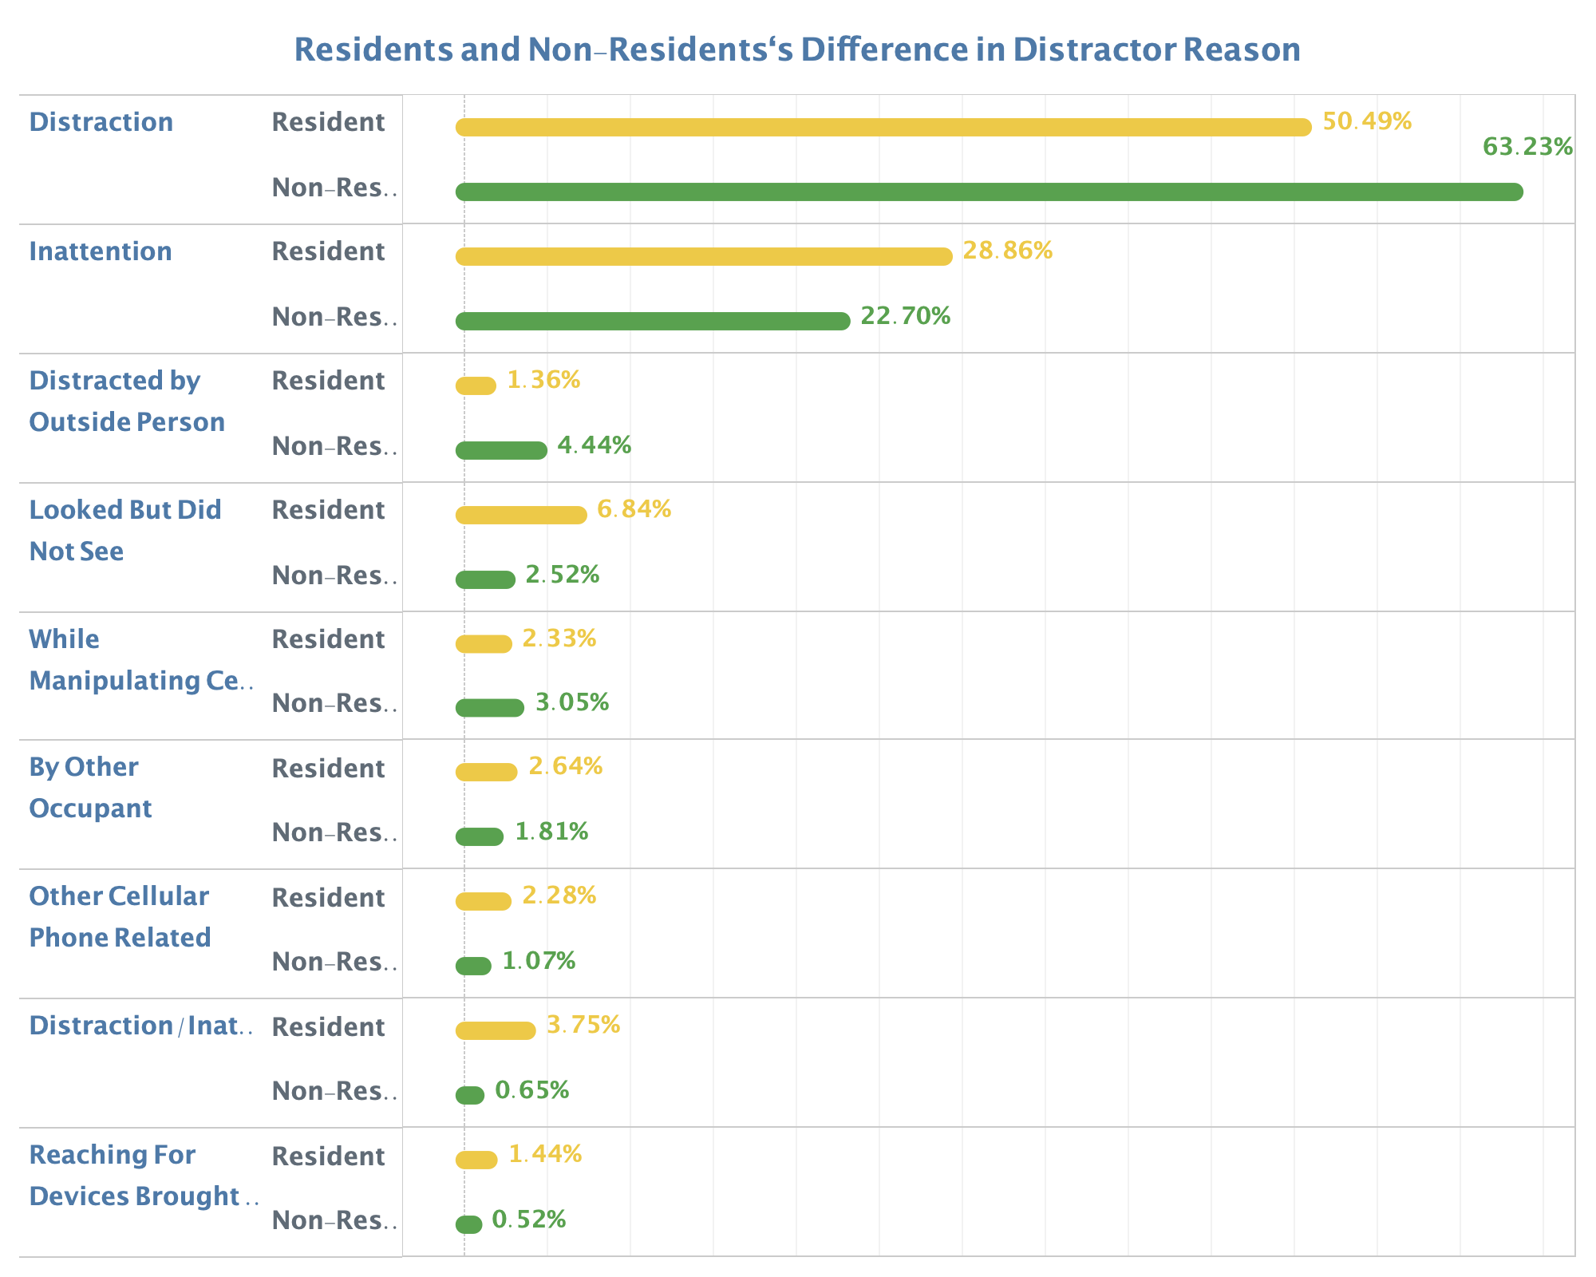
Resident VS. Non-resident
The chart shows the proportion of fatal accidents by distraction factors, in resident and non-resident drivers separately.
Compared to resident drivers, non-resident drivers in accidents are more likely to be involved with inattention, looked but did not see, distracted by outside person, talking or listening to phone, and eating or drinking.
Notes:
Behavior factor

Slide 12
Conclusion
Why non-resident drivers shows a much higher percentage in all fatal accidents?
Unfamiliar with local traffic can lead to frequent lateral move, deceleration and leaving improper lane. This could be the main reason of such high fatal accident percentage.
Distraction might be another reason for accidents with non-resident drivers.

Slide 13
Question
Is there any region that tend to produce higher-risk drivers that are involved in fatal crashes at a higher rate?

Slide 14
Region with higer-risk Drivers?
The distribution of case proportion across zip codes is similar to Pareto distribution.
Few areas account for most of the risky drivers.
Notes:
Behavior factor

Slide 15
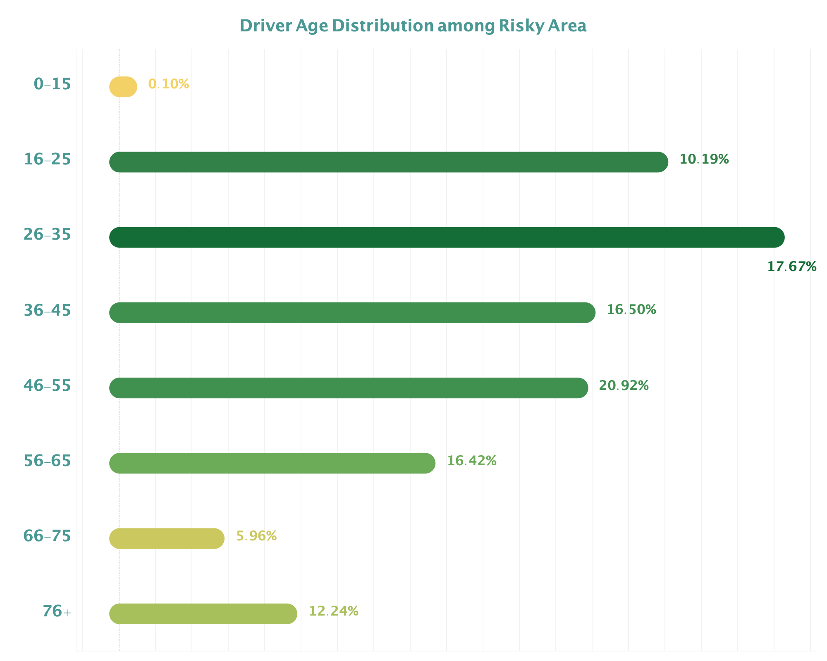
Drivers In High-risk Area
Washington Population^{[1]}
vs.

Slide 16
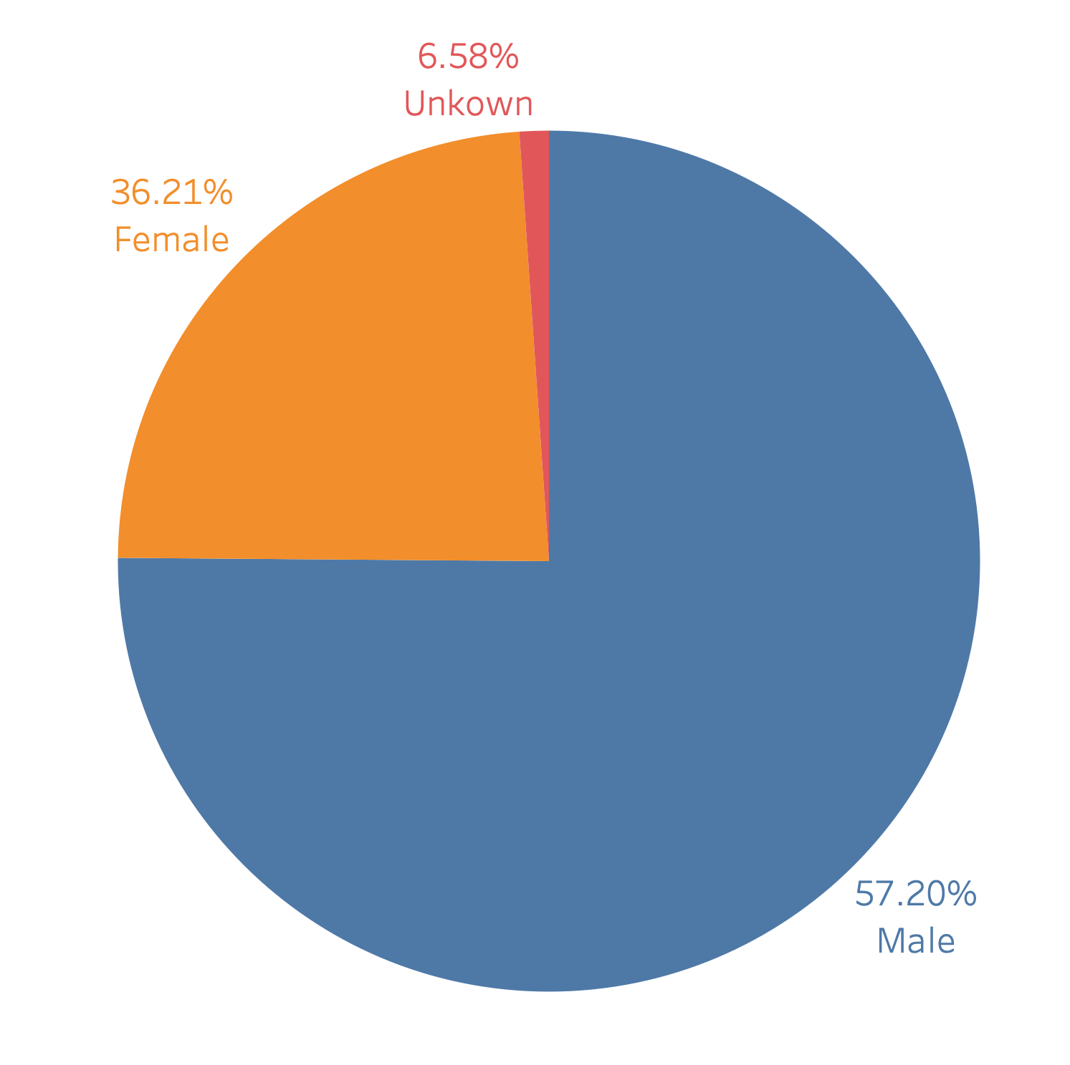
Drivers In High-risk Area
Washington Population^{[1]}
vs.

Slide 17
Seasonality
Seasonality in the number of fatal crashes throughout a year.
February appears to be the month with fewest number of crashes.
From 2017 through 2021, the monthly total of fatal crashes peak during July or August.

Slide 18
Conclusion
The number of monthly fatal accidents is related to temperature. The higher the temperature, the more fatal accidents.
Increased outdoor activities due to fine weather from June to August may lead to more fatal accidents.

Slide 19
How to improve?
Predict potential accidents and warn drivers!

Slide 20
Prediction
Models
Results
Random Forest, Decision Tree and Baseline
Accuracy: 61.2% F1 score: 0.522
Variables
Training and validation
Target: Crash Category
Independent: Location, Weather Condition, Light Condition, etc.
Scikit Learn Library

Slide 21
References
[1] Population Estimates | Office of Financial Management https://ofm.wa.gov/washington-data-research/population-demographics/population-estimates
[2] https://www.washington-demographics.com/zip_codes_by_population

Slide 22
Thanks!
Any questions?

